Slide 1

Chapter 6
Ready Notes
For in-class note taking, choose Handouts or Notes Pages from the print options, with three slides per page.
Making Decisions and Solving Problems

Slide 2

Chapter Objectives
Specify at least five sources of decision complexity for modern managers.
Define and explain the three decision traps: framing, escalation of commitment, and overconfidence.
Discuss why programmed and non-programmed decisions require different decision-making procedures and distinguish between the two types of knowledge in knowledge management.
Summarize the advantages and disadvantages of group decision making.

Slide 3
Chapter Objectives (cont’d)
Define creativity, and identify and describe five of the ten “mental locks” that can inhibit creativity.
List and explain the four basic steps in the creative problem-solving process, and describe how causes of problems can be tracked down with fishbone diagrams.

Slide 4
Challenges for Decision Makers
Decision Making
  The process of identifying and choosing alternative courses of action to meet the demands of a situation.
Trends in Decision Making
  The pace of decision making is accelerating: managers report making more decisions and having less time to make them.
    Complex streams of decisions
    Sources of decision complexity
    Perceptual and behavioral decision traps

Slide 5
Challenges for Decision Makers (cont’d)
Dealing with Complex Streams of Decisions
  Multiple criteria to be satisfied by a decision.
  Intangibles that often determine decision alternatives.
  Risk and uncertainty about decision alternatives.
  Long-term implications of the effects of the choice of a particular alternative.
  Interdisciplinary input increases the number of persons to be consulted before a decision is made.

Slide 6
Challenges for Decision Makers (cont’d)
Dealing with Complex Streams of Decisions (cont’d)
  Pooled decision making increases the number of persons playing a part in the decision process.
  Value judgments by differing participants in the process create disagreement over whether a decision is right or wrong, good or bad, and ethical or unethical.
  Unintended consequences occur because the results of purposeful actions cannot always be predicted.

Slide 7
Avoiding Perceptual and Behavioral Decision Traps
Framing Error
  The way in which information is presented influences one’s interpretation of it, which, in turn, may alter a decision based on the information.
Escalation of Commitment
  Continuing on a course of action that locks a person into losing position—“Throwing good money after bad.”
Overconfidence
  Believing too much in one’s own capabilities.

Slide 8
Coping with Uncertainty
Types (Conditions) of Uncertainty
  Certainty: exists when a solid factual basis allows prediction of decision’s outcome.
  Risk: exists when a decision is made on the basis of incomplete but reliable information.
    Objective probabilities: based on reliable data.
    Subjective probabilities: based on judgment.
  Uncertainty: exists when no reliable data exists on which to base a decision.

Slide 9
Making Decisions
Types of Decisions
  Programmed decisions: repetitive and routine decisions.
    Decision’s rule identifies the situation and specifies how the decision will be made.
  Nonprogrammed decisions
    Decisions made in complex and nonroutine situations.
      Problem hasn’t arisen before.
      It is difficult to define problem’s nature and structure.
      Problem is important and requires a unique solution.

Slide 10
Making Decisions (cont’d)
Nonprogrammed decisions—questions to ask:
  What decision needs to be made?
  When does it have to be made?
  Who will decide?
  Who needs to be consulted?
  Who will ratify or veto the decision?
  Who will need to be informed?

Slide 11
A General
Decision-Making Model
Rational (Logical) Decision Model Steps
  Scanning the situation—identifying a signal that a decision should be made.
    Receipt of authoritative communications from superiors.
    Cases referred for decision by subordinates.
    Cases originating from the manager.
  Classify the decision as routine, apply the appropriate decision rule; as nonprogrammed, begin comprehensive problem solving.
  Monitor and follow-up as necessary.

Slide 12

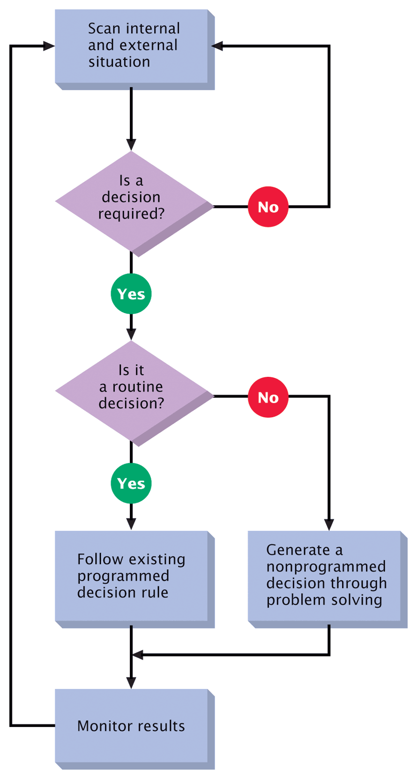
Figure 6.3
A General-Decision Making Model

Slide 13
A General
Decision-Making Model (cont’d)
Knowledge Management (KM): A Tool for Improving the Quality of Decisions
  Developing a system to improve the creation and sharing of knowledge critical for decision making.
  Tacit knowledge: personal, intuitive, and undocumented private information.
  Explicit knowledge: readily sharable public information in verbal, textual, visual, or numerical form.

Slide 14
A General
Decision-Making Model (cont’d)
Improving the Flow of Knowledge
  The flow of constructive tacit knowledge between coworkers is a priority.
  Knowing what you know, what you don’t know, and how to find what you know yields better and more timely decisions.

Slide 15
A General
Decision-Making Model (cont’d)
Improving the Flow of Knowledge (cont’d)
Organizational learning
Organization cultures
Training
Communication
Empowerment
Participative management
Virtual Training
Communication

Slide 16
Groups and Decision Making
Group Involvement in Decisions
  Analyzing the problem
  Identifying components of the situation
  Estimating components of the situation
  Designing alternatives
  Choosing an alternative

Slide 17
Groups and Decision Making (cont’d)
The Problem of Dispersed Accountability
  Results in loss of personal/individual accountability.
  Individual accountability is required when
    the decision will have significant organizational impact.
    the decision has ethical and legal ramifications.
    a competitive award is tied to the decision.

Slide 18
Managerial Creativity
What is Creativity?
  It is the reorganization of experience into new configurations.
  A function of knowledge, imagination, and evaluation
Three domains of creativity
  Art (ah!) as in beauty
  Discovery (aha!) as in enlightenment.
  Humor (haha!) as in joyful pleasure.

Slide 19
Learning to Be More Creative:
Mental Locks That Stifle Creativity
Looking for the “right” answer.
Always trying to be logical.
Strictly following the rules.
Insist on being practical.
Avoiding ambiguity.
Fear and avoiding publicity.
Forgetting how to play.
Becoming too specialized.
Not wanting to look foolish.
Saying “I’m not creative.

Slide 20
Problem Solving
Problem Solving
  The conscious process of closing the gap between actual and desired situations.
Steps in Managerial Problem-Solving
  Identifying the problem
  Generating alternative solutions
  Selecting a solution
  Implementing and evaluating the solution

Slide 21
Problem Solving (cont’d)
Identifying The Problem
  Involves asking the right questions.
What Is a Problem?
  Defined by the gap between actual and desired state of affairs.
Stumbling Blocks for Problem Finders
  Defining the problem according to a possible solution.
  Focusing on narrow, low-priority areas.
  Diagnosing problems in terms of their symptoms rather than causes.

Slide 22
Problem Solving (cont’d)
Cause
  The variable(s) responsible for the problem.
Pinpointing Causes with Fishbone Diagrams
  A TQM process improvement tool that shows possible problem causes and their interactive relationships.

Slide 23
Problem Solving (cont’d)
Generating Alternative Solutions
  Brainstorming
  Free association
  Edisonian
  Attribute listing
  Scientific method
  Creative Leap

Slide 24
Problem Solving (cont’d)
Selecting a Solution
  Resolving the problem
    Satisfice: to settle for a solution that is good enough rather than the best possible.
  Solving the problem
    Optimize: systematically identifying the solution with the best combination of benefits
  Dissolving the problem
    Change the situation in which the problem occurs so that the problem (and the conditions that cause it) no longer exists.

Slide 25
Creative Problem Solving (cont’d)
Implementing and Evaluating the Solution
  Effective and efficient resolution removes the gap between actual and desired states.
  If problem persists, recycling through the problem-solving steps becomes necessary.
    Trying other feasible solutions.
    Redefining the problem and beginning the problem-solving cycle again.
  The end result is continuous improvement.

